Slide 2
Why MedsPaL?
Needed to collect patent status information on priority medicines in LMICs for the MPP’s licensing work
Realized major challenges in collecting such information:
Difficult to identify relevant patents (searches by INN did not yield suitable results)
Many LMIC patent offices did not have searchable on-line databases
Some only allowed searches with patent number
Others only allowed searches in local language
Others published patent applications/grants but not legal status
MPP set out to collect such information from patent offices one by one (sometimes aided by WIPO, local patent attorneys, national patient groups, etc)
Started getting calls from public health stakeholders for such information and requests to make it public

Slide 3
Patent and licensing transparency
FREE source of information on the patent and licensing status of selected HIV, hepatitis C, tuberculosis and other patented essential medicines included in the WHO Model List of Essential Medicines in low- and middle-income countries.
Patent status data on more than
Covering approximately
With information on
And data exclusivity information from
8000
100
40
15
national patent applications
priority medicines
licences
countries
and other access agreements in LMICs
from over 130 LMICs
(approx. 200 formulations)
www.medspal.org
Widely endorsed by public health organisations:
Last update: October 2019

Slide 4
How is national/regional patent data obtained?
Identification of basic/relevant patents
Collection of related patent family information
INPADOC Patent family
USFDA Orange book
Published patent landscapes (e.g. by WHO or UNITAID)
Online national and regional PO registers
National patent collections on WIPO PatentScope
INPADOC Legal Status data
Direct communications with patent offices, local experts
MOUs with patent offices
Status check & updates
Publicly available licences
Health Canada patent register
WIPO Patentscope
Patent holder disclosures (e.g. to national patent offices; Pat-Informed, MPP licences)
Automated processes

Slide 5
MOUs with national/regional patent offices
Regional
African Regional IP Organisation
Eurasian Patent Office
European Patent Office
National
Argentina
Brazil
Chile
Dominican Republic
Ecuador
Egypt
Peru
South Africa
Uruguay
El Salvador
13 patent offices have signed MoUs with the MPP committing to share data

Slide 6
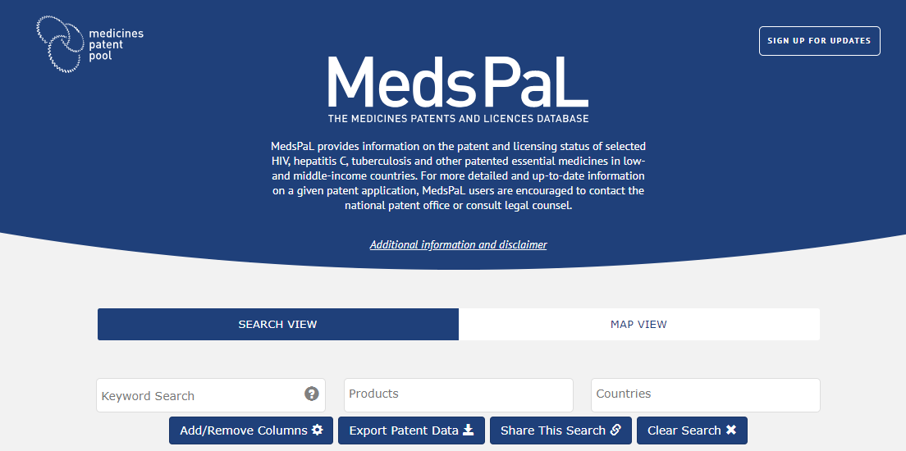
Search view
Search by keywords across all fields (e.g. patent number; brand name; country, etc.)
Pre-determined search by Products (e.g. Abacavir 300mg)
Search by Countries (e.g. Chile, South Africa, Vietnam)

Slide 7
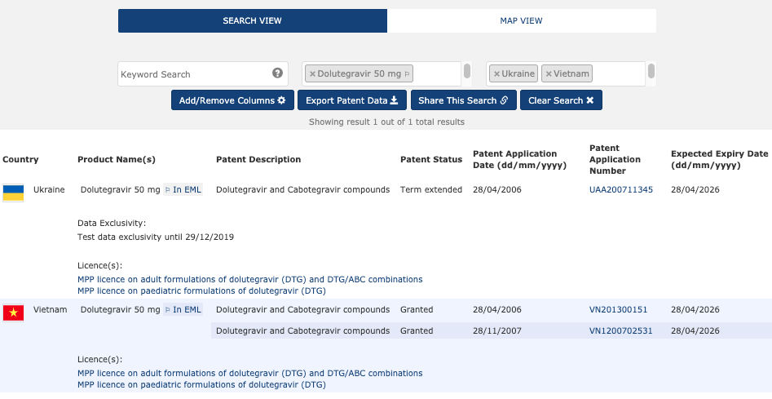
Search results
Data exclusivity
Patent/Patent application information
Licence information
Notes:
Combine searches
Patent description: A basic description developed by the MPP of what the relevant international patent application(s) is claiming in relation to a product.
Explain expiry dates and patent application

Slide 8
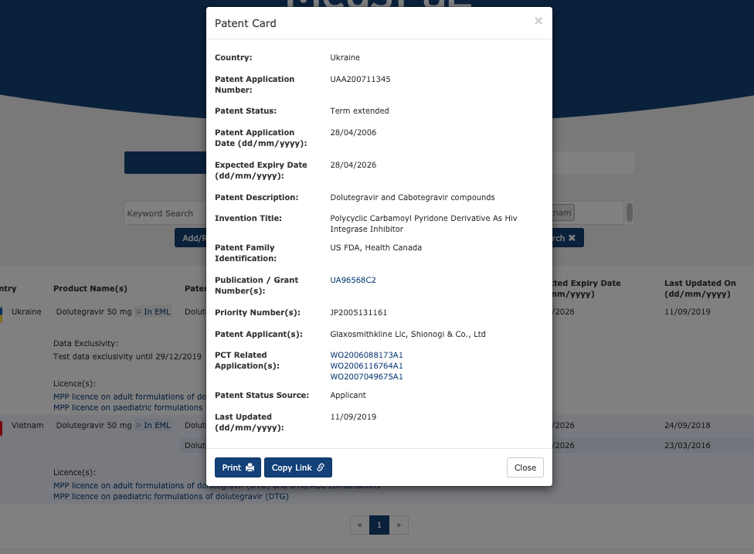
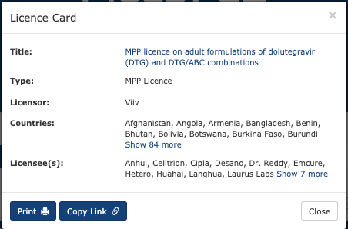
Patent & Licence Cards
Link to Espacenet
Link to MPP website

Slide 9
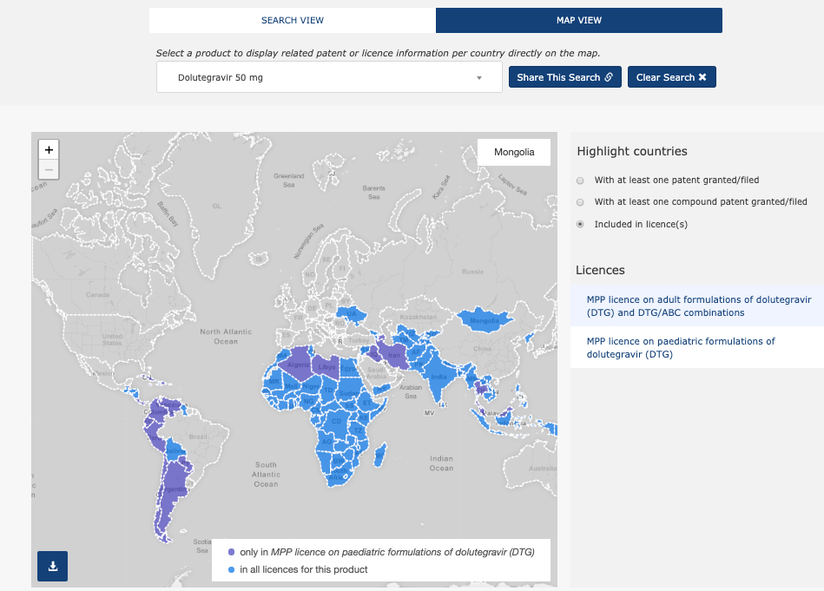
Map view

Slide 10
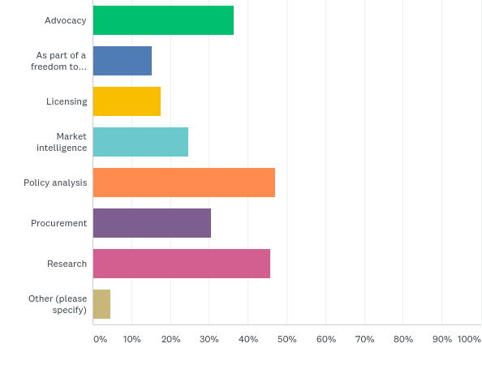
What is MedsPaL used for?
N: 85 Q5: What do you use it for? (You can select more than one option)
Follow-up interviews with 7 procurement agencies to gain further insights on how it’s used and how it could be improved

Slide 11
THANK YOU
@MEDSPATENTPOOL
WWW.MEDICINESPATENTPOOL.ORG
WWW.MEDSPAL.ORG
Eburrone@medicinespatentpool.org
Amaillard@medicinespatentpool.org

